Slide 1
Fiscal 101
AmeriCorps Advantage: CaliforniaVolunteers Grantee Training Conference, July 2017
Anthony Chavez
Chief of Staff
AmeriCorps Grantee Training Conference 2017

Slide 2
Presentation Goals
Cost Principles
Documentation and Fiscal Systems Basics
Budget Development
Invoices
Federal Financial Reports
Budget Amendments
AmeriCorps Grantee Training Conference 2017

Slide 3
So You Know You Are Spending Federal $?
AmeriCorps Grantee Training Conference 2017

Slide 4
Basics of OMB 2CFR Part 200
Cost Principles
Allowable & Unallowable Costs
Administrative Requirements
Accounting System to track Federal cost & match
Documentation Requirements
AmeriCorps Grantee Training Conference 2017

Slide 5
Cost Principles
Provide guidance to determine the allowable costs that can be
incurred by organizations under Federal grants
Designed so that Federal awards bear their fair share of costs
Provide guidance about reimbursement requirements
Provide uniform standards of allowability and allocation
Encourage consistency of treatment of costs
AmeriCorps Grantee Training Conference 2017

Slide 6
Allowable, Reasonable & Allocable
Allowable- A cost within award limitations, consistent,
documented, reasonable & allocable
Reasonable- A cost that does not exceed what a prudent person
would do under the circumstances at the time the decision
Allocable- Treated consistently with other costs incurred for the
same purpose in like circumstances and benefits the award and can
be distributed proportionally to the benefits received
AmeriCorps Grantee Training Conference 2017

Slide 7
Administrative Accounting System Requirements
Distinguish grant verses non-grant related expenses
Identify cost by program year & budget category
Differentiate between direct and indirect costs
Account for each award/grant separately
Record in-kind contribution as both revenue & expense
Provide management with financial reports at both the summary or
detailed levels that will compare outlay with budget amounts
Correlate financial reports submitted to CNCS directly to accounting
information and supporting documents
AmeriCorps Grantee Training Conference 2017

Slide 8
Acceptable Match is…………..
Cash and in-kind contributions are accepted as part of the grantee’s cost sharing or matching when contributions meet all of the following criteria:
Are verifiable from the grantee’s records and properly documented (handout)
Are necessary and reasonable for proper and efficient accomplishment of
project or program objectives
Are allowable under the applicable OMB cost principles
Are not paid by the Federal Government under another award, except
where authorized by the Federal statute to be used for cost sharing or
matching
Are provided for in the approved budget (allowable under program guidelines)
Conform to other grant provisions or OMB Circulars
AmeriCorps Grantee Training Conference 2017

Slide 9
Grants Management Components
Regulations & Requirements (Terms &Conditions/ OMB Super Circular)
Financial Management Principles
Policies & Procedures
Internal Controls
Administrative Costs
Documenting Expenses
Match
Reporting & Budgeting (Amendments)
Site Visits
Grant Closeout
AmeriCorps Grantee Training Conference 2017

Slide 10
Program and Fiscal Staff Coordination
Key to Comprehensive Grant Compliance
CV staff (program and fiscal) work together in reviewing subgrantee reporting and monitoring results.
Your Organization must have Policies and Procedures that Reflect AmeriCorps Grant Requirements
Audits start with organization’s policies and procedures
Lays out responsibility within the organization
AmeriCorps Grantee Training Conference 2017

Slide 11
Documentation and Fiscal Systems Basics
AmeriCorps Grantee Training Conference 2017

Slide 12
Documentation Basics
Why Retain Documentation?
It is required by federal regulations and your contract with the state.
Supports a value, cost, or performance criteria relative to the grant
To track incoming information
To validate information provided by staff, members and/or donors
To provide evidence of accomplishments
To assist during the monitoring activities, audits, or site visits
No documentation may mean no “credit” during a review.
AmeriCorps Grantee Training Conference 2017

Slide 13
Documentation Basics
Keep Your Documents Organized (systematically)
By grant
By program year
By type of document
Physical information:
Hard copy
Soft copy: CD, flash drive, server, microfilm
Source:
Internal to the organization
External sources
Should reflect appropriate review, approval, sign-off
Examples: Invoices, receipts, timesheets, contracts, in-kind contribution forms, checks deposited, travel claims
AmeriCorps Grantee Training Conference 2017

Slide 14
Fiscal Systems
AmeriCorps Grant Provisions
“Financial management systems must be capable of distinguishing expenditures attributable to this grant from expenditures not attributable to this grant. The systems must be able to identify costs by programmatic year and by budget category and to differentiate between direct and indirect costs or administrative costs.”
➔ Record in-kind contribution as both revenues and expenses
AmeriCorps Grantee Training Conference 2017

Slide 15
Budget Development
AmeriCorps Grantee Training Conference 2017

Slide 16
Budget Development Items of Note
Narrative detail is important – if we can’t tell what you have budgeted, it
may be disallowed during a compliance review
Calculations must equal amounts reported in budget
Category Overview
Personnel Expenses
Personnel Fringe Benefits
1 Staff Travel
2 Member Travel
Equipment
Supplies
Contractual & Consultant Services
1 Staff Training
G. 2 Member Training
H. Evaluation
I. Other Program Cost
Member Living Allowance
Member FICA
Member Worker’s Comp
Member Health
Other Member Cost
AmeriCorps Grantee Training Conference 2017

Slide 17
Section I Costs A. Personnel
Allowable
Salaries for individuals directly involved in operating the AC program (do not include administrative positions)
Staff time is budgeted
Supported by functional timesheets that are signed by employee an supervisor
Unallowable
Not supported by timesheets
Timesheets are not functional
Payroll reports not available or do not tie to General Ledger (GL)
Salaries associated with Admin positions
AmeriCorps Grantee Training Conference 2017

Slide 18
Section I Costs A. Personnel (Cont.)
Allowable
Must submit Payroll reports that tie to GL
If match, supported by invoiced from partners
Unallowable
Personnel Costs for staff not budgeted
Personnel Costs without functional timesheets
AmeriCorps Grantee Training Conference 2017

Slide 19
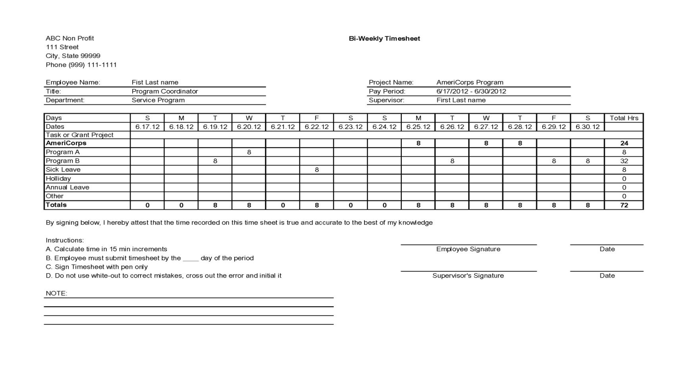
Functional Timesheet Sample
AmeriCorps Grantee Training Conference 2017

Slide 20
Personnel Electronic Timekeeping System Requirements
CNCS policy allows AmeriCorps State and National grantees to use electronic timekeeping systems as the system of record when three conditions are met:
A written policy is in effect establishing the use of electronic timekeeping system as your system of record; and,
A secure, verifiable electronic signature system (a) identifies and authenticates a particular person as the source of the electronic signature; and (b) indicates such person’s approval of the information contained in the electronic message.
Once appropriate electronic signatures have been applied, no changes may be made unless there is a clear, auditable record of the revision.
AmeriCorps Grantee Training Conference 2017

Slide 21
Section I Costs B. Benefits (Staff & Member)
Allowable
Budgeted
Supported by payroll reports
Supported by GL
FICA is correctly calculated
Helps if backup is easy to follow or if a key is provided
Include only for direct program positions
Unallowable
Over budget
Does not tie to payroll records or GL
FICA incorrectly calculated
Employee or member deductibles
Benefits associated with Admin positions
AmeriCorps Grantee Training Conference 2017

Slide 22
Section I Costs C. Travel (C1. Staff & C2. Member)
Allowable
Federal Per Diem Rates
Meals on overnight trips or “working lunches” during a conference or training ONLY
Mileage, as specified
Must have ALL receipts AND Travel Expense Claims
Unallowable
Out-of-State-Travel (unless pre-approved)
FOOD except on overnight trips or “working lunches” during a conference/training
Commute costs (home to work) -including public transit
AmeriCorps Grantee Training Conference 2017

Slide 23
Travel
Federal reimbursement rates for travel and/or per diem shall be used unless your existing policy requires less expense for travel and per diem.
State Offices need to use the State Rate established by CalHR.
AmeriCorps Grantee Training Conference 2017

Slide 24
Section I Costs D. Equipment
Allowable
Prior authorization required
Purchase price is over $5,000 (per piece)
Depreciates over time
Disposition must be approved/agreed upon prior to end of contract period
Budgeted
Unallowable
Any item over $5,000 purchased without advance approval
AmeriCorps Grantee Training Conference 2017

Slide 25
Section I Costs E. Supplies
Allowable
Consumables such as office supplies and minor equipment (less than $1,000) needed to run your program
Supported by receipts
Must be budgeted
Unallowable
Food
Items claimed without receipts
Items that are not budgeted
AmeriCorps Grantee Training Conference 2017

Slide 26
Section I Costs F. Contracts
Allowable
Limited to CV policy for daily rate at $750
Must submit contract/invoice
Must be budgeted
Not in lieu of employees
Unallowable
Contracts that exceed daily rate
Contracts that are not budgeted or contractor is substituted without budget revision
Invoice is not provided
AmeriCorps Grantee Training Conference 2017

Slide 27
Section I Costs G. Training (G1. Staff & G2. Member)
Allowable
Budgeted
Reasonable
Agenda is provided and content is reasonable (i.e., program related and not entertainment)
Food is limited to working lunch only and does not exceed CalHR per diem rate ($10 per person)
Unallowable
Over budget
Substitute contractors
Content that is entertainment
Gifts/cash/incentives for members
Snacks/water
Food other than working lunches
AmeriCorps Grantee Training Conference 2017

Slide 28
Section I Costs G. Training (Cont.)
Allowable
Provide attendee sign in sheet for each day to “get credit” for working lunches
If agenda is not on keynote speaker’s letterhead, an invoice from the “working lunch” speaker must be provided.
Staff Development
Unallowable
Costs submitted without invoices and sign-in sheets
Content that is not program-specific
AmeriCorps Grantee Training Conference 2017

Slide 29
Section I Costs H. Evaluation
Allowable
Budgeted
Direct costs including consultants and instrumentation
Indirect costs such as additional staff time
Daily rate $750
Unallowable
Daily/weekly data gathering to assess progress toward objectives
AmeriCorps Grantee Training Conference 2017

Slide 30
Section I Costs I. Other
Allowable
Fingerprinting
Background Checks
Health Tests/Immunizations
Facilities Costs for direct program use only
Utilities (including internet) for direct program use only
Unallowable
Facilities and utilities for administrative staff/use
Entertainment of any kind
Gifts/Incentives
Unreasonable or unnecessary purchases – use conservative common sense!
Reimbursements (personal cell phone, etc.)
AmeriCorps Grantee Training Conference 2017

Slide 31
Section I Costs J. Member Living Allowance
Allowable
Must be supported by member timesheets signed by both member and supervisor
Must be supported by member roster in eGrants
Must match number and types of slots budgeted
Unallowable
Members not on approved roster
Unsigned or missing timesheets
AmeriCorps Grantee Training Conference 2017

Slide 32
Reimbursements
AmeriCorps Grant Provisions
“A living allowance is not a wage. Programs must not pay a living
allowance on an hourly basis. Programs should pay the living
allowance in regular increments, such as weekly or bi-weekly,
paying an increased increment only on the basis of increased
living expenses such as food, housing, or transportation.
Payments should not fluctuate based on the number of hours
served in a particular time period, and must cease when a
member concludes a term of service.”
No “lump sum” if member completes term early
No “lump sum” if member starts late, e.g., “make up” missed payments
AmeriCorps Grantee Training Conference 2017

Slide 33
Admin Costs
What is included?
Costs for financial, accounting and related services
Costs for internal evaluation
Costs for General Liability insurance for the organization (member’s liability ins can be a direct charge if budgeted as such)
What is not included?
Costs for independent or internal evaluations specifically related to creative methods of quality improvement
Costs for rent, utilities and legal services for program staff/ops
Allowable direct charges
AmeriCorps Grantee Training Conference 2017

Slide 34
Admin Costs
What is included? (Cont.)
Costs for rent, utilities and legal services for admin staff
Portions of salaries and benefits of the Program Directors and other admin staff not attributable to time spent in support of a specific program
What is not included?
Costs for staff who recruit, train, place or supervise members or who develop materials used in such activities
Costs related to staff that work in a direct program support, operational or oversight capacity
AmeriCorps Grantee Training Conference 2017

Slide 35
Admin Costs How is it Calculated?
Method A: Fixed Rate
Total of Program Costs
Multiplied by:
0.0526 x 0.6 =
Admin Costs (CNCS Share)
0.0526 x 0.4 =
Admin Costs (CV Share)
Grantee Share (Match) may be up
to an additional 10% of Total
Program Costs
Method B: ICRP
Admin Costs calculated using approved Indirect Cost Rate Plan (ICRP) methodology
Must provide approved ICRP at time of application
Complete backup required
CV Share is included in total ICRP
AmeriCorps Grantee Training Conference 2017

Slide 36
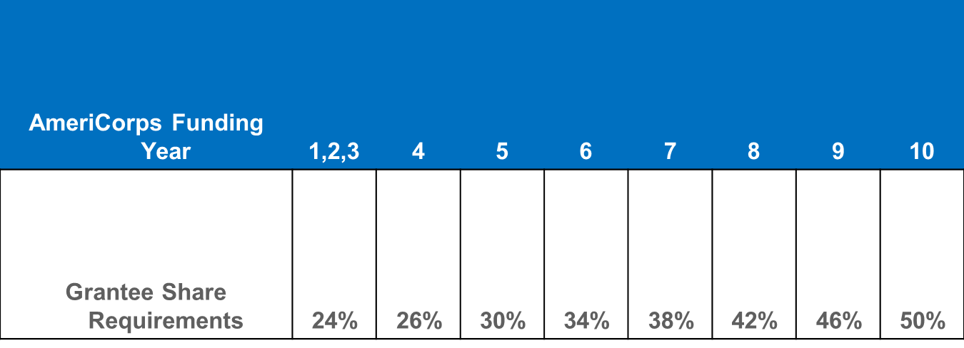
Matching Requirements
Documentation required to show in-kind and/or cash contributions
AmeriCorps Grantee Training Conference 2017

Slide 37
Invoices
AmeriCorps Grantee Training Conference 2017

Slide 38
Invoices
Reimbursement is made based on actual expenses
Reimbursements may not be for estimated, unauthorized, or unallowable expenses
Invoices must be for approved and budgeted expenditures that programs have already incurred
No advances allowed
AmeriCorps Grantee Training Conference 2017

Slide 39
Invoices
Must also have up-to-date and current:
Member hours
Expense Workbooks
Federal Financial Reports
Program Reports (performance-based)
Must also demonstrate compliance with program operations, i.e., no outstanding corrective action
AmeriCorps Grantee Training Conference 2017

Slide 40
Invoice Due Dates
Invoices are due by the 30th of the month following the invoice period
3 hard copies of the Expense Workbooks, which includes a coversheet and respective months of data for the claimed period
Invoices are submitted monthly
AmeriCorps Grantee Training Conference 2017

Slide 41
Invoice Reviews
Both the Grants Management Associate and Program Officer review the invoice for compliance and for approval of payment
CaliforniaVolunteers has the authority to hold invoices
PO reviews and approves for compliance relative to the program and then the GMA reviews for fiscal compliance
AmeriCorps Grantee Training Conference 2017

Slide 42
Invoice Review (cont.)
Only complete and approved invoices are submitted for payment – we send them back if there are errors
You can expect payment about 45 days after the day we receive the invoice
Important to submit monthly invoices to prevent cash flow problems
AmeriCorps Grantee Training Conference 2017

Slide 43
Monthly Expense Workbook
There is a sheet that has a YTD tool which has
alarms that tell you if you
Don’t have enough match,
Over expended a line item or
Calculated Indirect costs correctly
AmeriCorps Grantee Training Conference 2017

Slide 44
Federal Financial Reports
AmeriCorps Grantee Training Conference 2017

Slide 45
Key Elements of Financial Reporting
Prepare all financial reports with information from the organization’s accounting system
Review and reconcile the information to ensure accuracy prior to report submission
Submit all reports on time
Proofread before submitting—small errors will delay payment
AmeriCorps Grantee Training Conference 2017

Slide 46
Reporting Requirements Federal Financial Report (FFR)
Due to CaliforniaVolunteers office by the 15th day after the end of the reporting period
Must be submitted via hard copy
One (1) copy of the FFR is required
Required documents include:
Program Income Form
Submission of all invoices for reporting period
Reporting other federal grant sources
AmeriCorps Grantee Training Conference 2017

Slide 47
Late Reports?
Prior to the due date
By e-mail, request an extension
Provide reason why an extension is needed
State expected date of completion
Expense Reports and FFRs
Submit extension request to GMA (Gaylord)
CV reconciles FFRs to Expense Reports.
If they do not tie, expect a call or e-mail!
AmeriCorps Grantee Training Conference 2017

Slide 48
FFR Due Dates
FFR Due Dates for the 2017-18 Program Year
Period Claiming | Date FFR Due to CV
07/01/2016-09/30/2017 | 10/15/2017
10/01/2017-03/31/2018 | 04/15/2018
04/01/2017-09/30/2017 | 10/15/2018
10/01/2018-12/31/2018 | With final invoice or no later than 01/15/2018
AmeriCorps Grantee Training Conference 2017

Slide 49
Budget Amendments
What are the rules?
How do I submit one?
AmeriCorps Grantee Training Conference 2017

Slide 50
Budget Amendment Rules
Budget changes must not be implemented before CaliforniaVolunteers approves the change (i.e. don’t purchase/pay for items that are not in an approved budget at the time of purchase).
Adequate written justification must be provided with request—changes need to be consistent with program design and activities. Approval requires both program and fiscal ok.
Budget Amendment Request Form must be complete.
Do not submit a major budget change at year-end. This indicates inadequate monitoring of budget throughout the year. There is no guarantee that a year-end change will be approved and you may not be reimbursed for these expenses.
AmeriCorps Grantee Training Conference 2017

Slide 51
Budget Amendment Rules
CaliforniaVolunteers must receive written approval from CNCS for these budgetary changes:
Specific costs requiring approval under the cost principles, such as:
Overtime pay, rearrangement and alternation costs, and pre-award costs
Purchases of equipment over $5,000 using CNCS funds, unless specified in the approved application and budget
Changes in the cumulative budget line items that amount to 10% or more of the total budget, unless the CNCS share is $100,000 or less
The total budget includes both the CNCS and grantee shares
Grantees may transfer funds among approved direct costs categories when the cumulative amount of such transfers do not exceed 10% of the total budget
AmeriCorps Grantee Training Conference 2017

Slide 52
How to Submit a Budget Amendment Request
Submit a Budget Amendment Request Form
Narrative justification – explain why a redistribution of funds is needed and how your program is affected.
Spreadsheet with the original budget, proposed budget, and difference between two budgets
Must be signed by the Program Director and Legal Applicant and mailed to CaliforniaVolunteers GMA
GMA reviews for accuracy and forwards to Program Associate who reviews for programmatic elements
CaliforniaVolunteers will either approve or deny – wait to take action only after receiving approval
AmeriCorps Grantee Training Conference 2017

Slide 53
Budget Amendment Pointers
Your budget = plan of expected costs
Plan may change as the program is implemented
Review budget monthly
Request budget amendments promptly
Do not wait until last month of year to request budget modification
Budget is driven by program needs
AmeriCorps Grantee Training Conference 2017

Slide 54
Resources
http://www.californiavolunteers.org/granteecentral/index.php/GranteeCentral/
http://www.nationalservice.gov/build-your-capacity/grants/managing-americorps-grants
Questions?
Your Fiscal Team:
Anthony Chavez, Chief of Staff 916-323-7646
Amelyn Tadeo, Fiscal Monitoring Supervisor 916-323-7646
Gaylord Daluz, Grants Management Associate 916-323-7646
Angela Khani, Business Services Associate 916-323-7646
AmeriCorps Grantee Training Conference 2017

