Slide 1
AmeriCorps Advantage: A Career Resource Guide for Life After AmeriCorps
AmeriCorps Advantage: CaliforniaVolunteers Grantee Training Conference, July 2017
Andrea Weiss, MS, NCC, MCC
www.weisscareer.com
Kari MacDonald, Project Lead
CaliforniaVolunteers
AmeriCorps Grantee Training Conference 2017

Slide 2
Introduction and Vision
The inspiration: Members and Programs
The solution: A Resource Guide
Partners who helped make it happen:
- CNCS
- AT&T
- AmeriCorps Alums
- Input from Programs: CCC, CalServes, City Year, Birth & Beyond and many others
AmeriCorps Grantee Training Conference 2017

Slide 3
The Vision Continues…Phase 2
Financial Literacy Module
Webinars and short videos
New methods for access and delivery
AmeriCorps Grantee Training Conference 2017

Slide 4
How To Use The AmeriCorps Advantage
Some programs have established curricula, or subcontract training to others-- some don’t. This is one of your tools.
The shift from manager of people and projects – to Career Counselor
Assist Grantees in delivering career development and job search support as members prepare for life after service
Facilitated AND self-led sections
AmeriCorps Grantee Training Conference 2017

Slide 5
How To Use This Guide…continued
Program Delivery and Distribution – physical and electronic versions ensure everyone has access (including remote programs without reliable internet)
2017-18 budgets are set, so we’re investigating a variety of ways to properly train you to deliver content
Recruitment and Retention – the ADVANTAGE of service
AmeriCorps Grantee Training Conference 2017

Slide 6
Helping Members as They Use the Guide
Begin, and continue, the career conversation
Be a supportive and encouraging resource
Share your career stories (good, bad, and ugly!)
Encourage exploration and questions
AmeriCorps Grantee Training Conference 2017

Slide 7
Jumping in: How and When to Start
Distribute Guide early in your training schedule, ideally within first 30 days
Start at the beginning!
Remember, only facilitated training can count towards training hours!
Stand alone training or along side other training
Integrate into other activities and events
Regular check-ins: progress, feedback, resources
Customize
AmeriCorps Grantee Training Conference 2017
Notes:
Introduce within first 30 days and follow the suggested timeline
Provide time during service to focus on career
Work through Guide from the beginning- do NOT jump to the job search section
Entire Guide can be self led but it will be MUCH more effective when some activities are done in a group setting
Use the recommended exercises in either specific career focused training sessions or along side other training
Integrate career learning into other activities/events (networking, practicing 30-Second Introduction) doesn’t always have to be a separate workshop
Schedule regular check-ins to monitor progress, provide feedback, guide toward resources

Slide 8
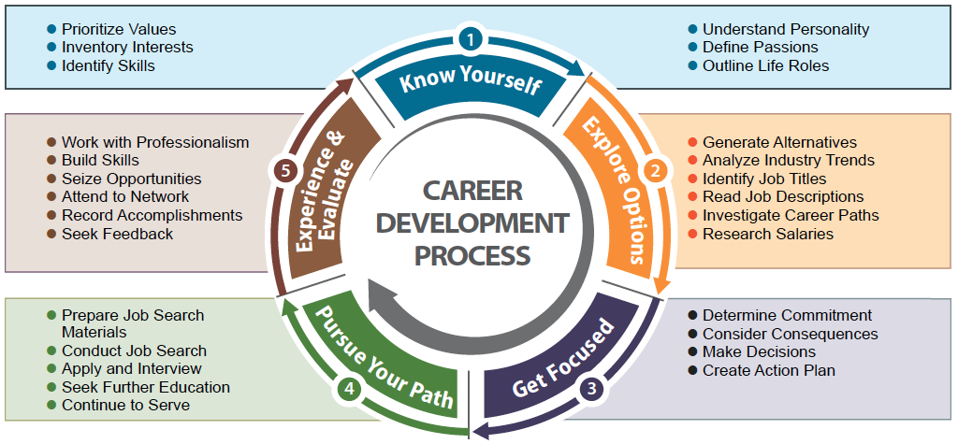
Career Development Process
AmeriCorps Grantee Training Conference 2017
Notes:
Introduce within first 30 days and follow the suggested timeline
Provide time during service to focus on career
Work through Guide from the beginning- do NOT jump to the job search section
Entire Guide can be self led but it will be MUCH more effective when some activities are done in a group setting
Use the recommended exercises in either specific career focused training sessions or along side other training
Integrate career learning into regular activities/events (networking, practicing 30-Second Introduction) doesn’t always have to be a separate workshop
Schedule regular check-ins to monitor progress, provide feedback, guide toward resources

Slide 9
Content: Overview
Introduction: Chapter 1
Know Yourself: Chapter 2
Explore Options: Chapter 3
Get Focused: Chapter 4
Pursue Your Path: Chapters 5 & 6
Experience and Evaluate: Chapter 7
Appendices
Resources
AmeriCorps Grantee Training Conference 2017

Slide 10
Icons
Exercises
Gems
Notes
Before You Move On
AmeriCorps Grantee Training Conference 2017

Slide 11
Chapter 1: Introduction
How to Use Guide: Timeline and Steps
Career Self Reliance
Career Development Process
Career Fitness Test
Career Zone Account
Voice Mail and Email
AmeriCorps Grantee Training Conference 2017

Slide 12
Chapter 2: Know Yourself
Values
Personality
Interests
Skills
Passions
Other Considerations
30-Second Introduction
Before You Move On
AmeriCorps Grantee Training Conference 2017
Notes:
Key Aspect of the Guide!!
When was the last time you spent some time reflecting on your career? Work through it yourself!
Before you move on: OK to be uncertain, recognize CCC

Slide 13
Chapter 3: Explore Options
Baker Tree of Options
Online Resources
Informational Interviews
Finding the Sweet Spot
AmeriCorps Grantee Training Conference 2017

Slide 14
Chapter 4: Get Focused
Decision Making Models
Goal Setting
Plan “B”
AmeriCorps Grantee Training Conference 2017

Slide 15
Chapter 5: Pursue Your Path-Job Search
Do NOT start here!
Preparing for Your Search: Resumes, Cover Letters, References, LinkedIn Profile
Launching Your Search: Networking, Job Boards, Career Fairs, Staffing Agencies
Applying and Interviewing: Customizing Documents, Interviewing, Salary Negotiation
AmeriCorps Grantee Training Conference 2017

Slide 16
Chapter 6: Pursue Your Path-Other Options
Further Education
Additional Term of Service
Entrepreneurship
AmeriCorps Grantee Training Conference 2017

Slide 17
Chapter 7: Experience & Evaluate
Professionalism
Staying Connected to AmeriCorps
Career Fitness Post-Test
AmeriCorps Grantee Training Conference 2017

Slide 18
Appendices
Referenced throughout the Guide
Some can be used in workbook form
Some can be downloaded as PDF’s from the CaliforniaVolunteers website
Recommended Reading
Lists of websites and apps
AmeriCorps Grantee Training Conference 2017

Slide 19
Resources
Business partners
Career counseling professionals
Local AmeriCorps Alums
CaliforniaVolunteers’ website for Exercises and Appendix items
AmeriCorps Grantee Training Conference 2017
Notes:
Engage business partners in the process- resume reviews, mock interviews, professionalism tips, mentor opportunities, networking, employer panels (HR Assoc.,
Seek out local career counseling professionals (NCDA, OneStops)
Involve local AmeriCorps Alums

Slide 20
Next Steps – We Need Your Input
Instant Read on Content – how did we do?
What worked? What needs to change?
Thoughts on content delivery – books, electronic, download, webinar, other?
Focus Group Volunteers needed – use the guide throughout the year and share your experience
AmeriCorps Grantee Training Conference 2017
Notes:
Engage business partners in the process- resume reviews, mock interviews, professionalism tips, mentor opportunities, networking, employer panels (HR Assoc.,
Seek out local career counseling professionals (NCDA, OneStops)
Involve local AmeriCorps Alums

Slide 21
Q & A
More thoughts and questions? Contact:
Kari MacDonald
Kari.macdonald@californiavolunteers.ca.gov
(916)319-9126
AmeriCorps Grantee Training Conference 2017

