Slide 1
My AmeriCorps Experience
By [Inset Name Here]

Slide 2
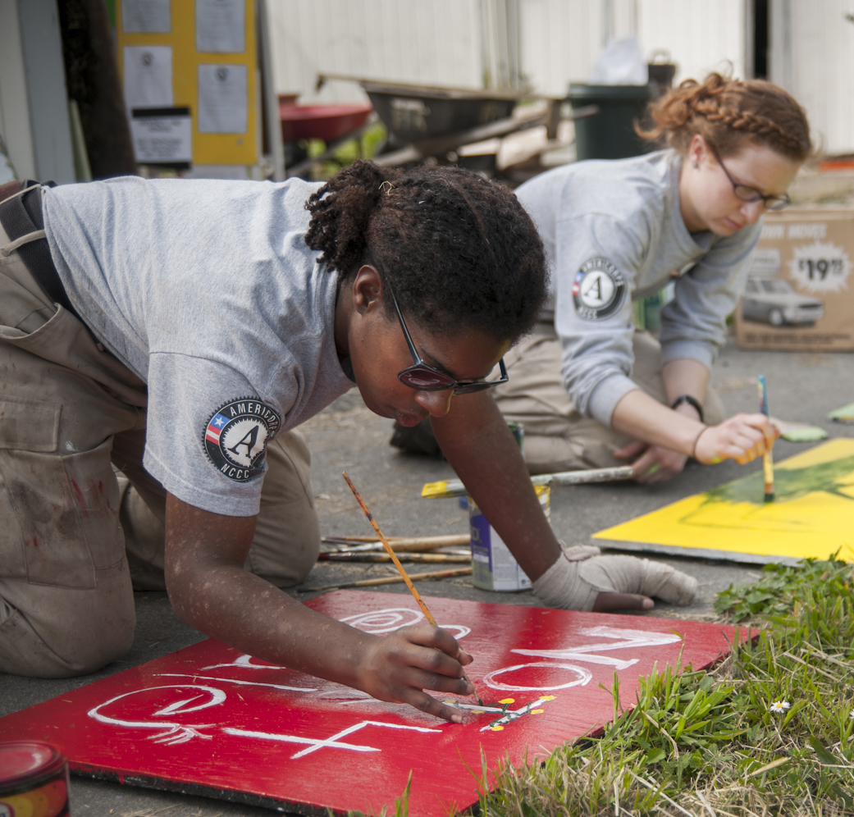
Overview
What is AmeriCorps?
What is a year of service?
What do service members do?
What do service members do after service?
How to apply/learn more?

Slide 3
What is AmeriCorps?
Like the Military or Peace Corps, AmeriCorps is a way to serve your country.
AmeriCorps members make Americans safer, stronger, and healthier. They strengthen our communities and above all, get things done.

Slide 4
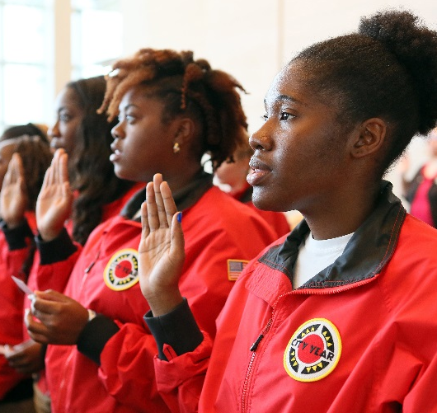
What We Do
More than 75,000 members join each year and tackle different issues in different ways.
For example,
AmeriCorps members help families obtain affordable housing, mentor students toward on-time graduation, and respond to natural disasters.

Slide 5
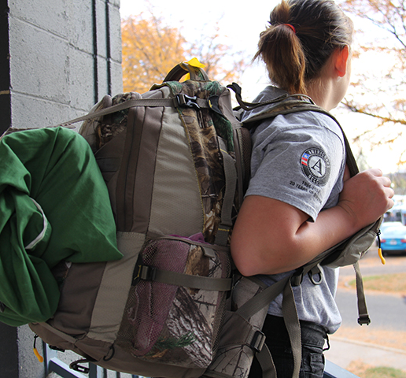
What is a ‘Year of Service?’
Serve from 3 months to one year, part-time or full-time positions available
Select a program that fits your interests and your availability
Gain leadership experience
Serve in your hometown or anywhere in the US!
Advance local solutions or travel the country and serve on several projects, all while earning money for school or student loans.

Slide 6
Our Focus
Disaster Services
Economic Opportunity
Education
Environmental Stewardship
Healthy Futures
Veterans and Military Families

Slide 7
What You Can Do
Service projects and tasks are as diverse as our members.
Examples include:
Assist with tax preparation
Obtain safe and affordable housing for veterans and military families
Conserve national parks
Tutor and mentor children from low-income families
Weatherize homes for seniors
And so much more!

Slide 8
Our Programs
AmeriCorps State & National
AmeriCorps VISTA
AmeriCorps NCCC
Hands-on experience
Serve within a nonprofit organization or city government
Over 75,000 members
Behind the scenes experience
Anti-poverty focused
Serve within a nonprofit organization or city government
8,000 members annually
Over 220,000 alumni
Direct service
Assigned to a campus
1,200 members
Up to 1,600 FEMA Corps Members

Slide 9
What are the Benefits?
Living Allowance
Receive a modest bi-weekly living allowance to cover basic expenses.
End of Service Award
Earn a Segal AmeriCorps Education Award ($5,920) to pay for current education expenses, and to repay qualified student loans.
Professional Development
Sharpen your skills and bolster your resume.
Health Benefit
Some AmeriCorps programs offer limited health benefit.
Jobs with Leading Employers
Connect to a network of over 500 employers from all sectors who value AmeriCorps experience.
And many more benefits...
You can find them at:
AmeriCorps.gov/Join

Slide 10
My AmeriCorps Experience
Placeholder for your AmeriCorps experience images.
Insert your own story on the right slide block.
When: 2015 - 2016
Where: Houston, TX
Organization: Volunteer Houston
Assignment: Volunteer Recruitment & Management Systems Specialist
Responsibilities:
Increase volunteerism in the Houston area and grow Volunteer Houston’s volunteer database.
Recruit users to register for volunteer opportunities and recruit local agencies to post volunteer opportunities.
Update Volunteer Houston’s volunteer database and online presence.
Why I chose to serve:
Give back to my country
Gain professional skills
Disclaimer: Opinions or points of view expressed in this presentation are those of the presenter(s) and do not necessarily reflect the official position of, or a position that is endorsed by, CNCS or the AmeriCorps program.”

Slide 11
Your Story
Placeholder for your AmeriCorps experience images.
Disclaimer: Opinions or points of view expressed in this presentation are those of the presenter(s) and do not necessarily reflect the official position of, or a position that is endorsed by, CNCS or the AmeriCorps program.”

Slide 12
My Service Year
Placeholder for your AmeriCorps experience images.
Insert your own story on the right slide block.
Accomplishments
Increased user base by over 60% (from 20,000 to 35,000 users).
Implemented Google AdWords campaign to improve website traffic.
Developed mobile app for finding volunteer opportunities.
Integrated Google Analytics and other data tools in organizational decision making.
Challenges
Learning new skills
Working in a new environment
Integrating into the community
What I gained/ learned
Leading the development of an online platform and mobile app
Ownership of an initiative and part of an organization
Experience working at a nonprofit
Experience working in a small business/start up environment
Disclaimer: Opinions or points of view expressed in this presentation are those of the presenter(s) and do not necessarily reflect the official position of, or a position that is endorsed by, CNCS or the AmeriCorps program.”

Slide 13
Life After Service
AmeriCorps alumni remain civically engaged after service.
28% are more likely to keep informed about public issues.
22% are more likely to volunteer.
30% are more likely to donate to a cause.
15% are more likely to participate in community organizations.

Slide 14
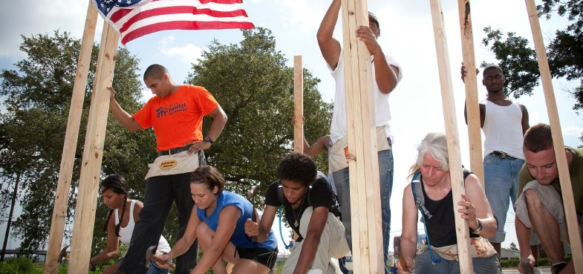
After Service
AmeriCorps Improves Employment Opportunities
67% of AmeriCorps members were employed 6 months after service
43% of AmeriCorps members were employed 6 months before service

Slide 15
How to Apply
Visit AmeriCorps.gov/join to search a variety of service opportunities and choose the one that is right for you.
1
Search Opportunities
2
Apply
Complete and submit an application.
The application assessment and selection is different for VISTA, NCCC and State/National. Learn more at AmeriCorps.gov/join.
3
Await Placement
Receive confirmation that you are selected to serve and begin service term shortly thereafter.
4
Begin Service

Slide 16
Questions?
Apply today at
AmeriCorps.gov

