Slide 1

Welcome to the new program year!
How’s recruitment going? Let us know in the chat box . . .

Slide 2

Please mute your phones . . .
Notes:
Welcome everyone! We’re excited it’s the start of a new program year of meaningful impact through national service – impact on your communities and the long-term impact serving will have on your AmeriCorps members!

Slide 3
Agenda
Program Timeline: Member Onboarding
Compliance Corner: Criminal History Checks
CNCS member enrollment re-cap
CV Updates
CNCS Recruitment Tool
Q & A
Notes:
Read slide

Slide 4




Program Timeline
Aug Sep Oct Nov Dec Jan Feb Mar Apr May Jun Jul Aug
Pre-Contracting
Program Readiness/Contracting (See checklists)
Recruiting ACMs /Inviting in eGrants (SSA check)
Criminal History Checks – certifying in eGrants
Partner training
Program
Start
Site Visiting, Support, Monitoring
Member Service Ends
Program
Close-out
AmeriCorps Members Serving + Ongoing Training
• Review your contract
• Service provision • Data collection • Timesheet approval
• Final data process
Onboard +
Train Members
Exit Members
Enroll Members in eGrants (5-day window)
Set-up member files
• eGrants (30 days)
Final Progress Report Due
(30 days post end date)
Progress Report due 1/15
Progress Report due 4/15
CV
Check-in
Call #1
Check-in
Call #2
Member File
Review
Check-in
Call #3
Aug Sep Oct Nov Dec Jan Feb Mar Apr May Jun Jul Aug
Notes:
Let’s take a look at the program year. CV grantees actually operate a 12-month program within an 18-month window (Aug. 2018-Dec. 2019). Let’s look at a typical program year that starts in August and is completed in terms of members serving, in 12 months. First is Pre-Contracting, which includes Program Readiness & Contracting document review, Recruitment, selection and pre-enrollment of members (CHC & SSA check and validation), and partner training. Then you get through the contracting process, which is where most of you are now, and begin to onboard and train members. Throughout the program year, your members provide service and receive ongoing training, support and member development. Meanwhile, you are ensuring things are going according to plan with your sites and partners by visiting and monitoring. All along the way you collect data as covered in your CV Performance Measure Worksheets, and before you know it, the year is over and member service ends. Along the way, CV is there to support you through Program Officer check-in calls, and you’ll provide several progress reports. We will also do a review of your member files to ensure everything is in order. We’ll provide monthly Training and Technical Assistance calls and webinars, along with pointing you to valuable resources on our website at Grantee Central. All of the resources we’ll share with you today, are available on Grantee Central..

Slide 5
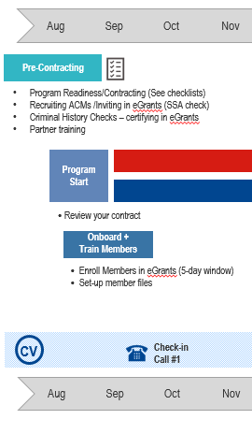
Re
Onboarding Members
Recruiting, screening, inviting in eGrants (starts the SSA verification process)
Criminal History Checks – Members (and staff): ALL 3 CLEARED before starting (note on CV NSCHC Verification Form)
Certify CHC in eGrants BEFORE member starts
Set Up Member Files (use CV Checklist)
Member Pre-Service Orientation
Enroll member is eGrants (within 5 calendar days after member starts – CHC and SSA check done prior)
Site Orientation
Notes:
So now most of you are heavily into the onboarding phase! This includes recruiting, screening, selecting members for service and inviting them to begin enrollment in egrants – which starts the SSA verification process. You’re conducting compliant Criminal History checks for members and any new staff on the budget (which includes site partner staff like site supervisors if you’re counting their time as in-kind match on your budget). Then you’re certifying having done the CHC checks in egrants for each member. In all of this your setting up member files using CV’s MF Checklist (included in our downloadable documents in go-to-webinar, but also in your Welcome Packet as well as on Grantee Central)., conducting pre-service orientation, and then that last step of hitting the enroll button in egrants within 5 calendar days of each member’s first day. This is usually followed by Core Training and Site Orientation for the members.

Slide 6
Compliance Corner:
Criminal History Checks:
Federal law finalized in 2012
45 CFR §§ 2540.200 – 2540.207
CV’s stricter requirements: Exhibit H of contract
Notes:
Since Criminal History Checks are so critical for both the safety of your program and to avoid cost disallowance, we’d be remiss if we didn’t do a quick reminder at this time of year – especially for those who are yet to start and still in the recruitment phase. There is a full training on our website, but today we’ll just do a short review and show you where to find resources are on Grantee Central.
As you all know, National Service Criminal History Checks are a federal requirement that has evolved over the years. The present requirements were finalized in 2012, known as the final rule, and came into effect in January of 2013. These established CNCS minimum requirements. Each state commission is allowed to have stricter requirements and CV chose to do so. These can be found in Exhibit H of your contract, which is signed by your legal applicant representative indicating their understanding of and adherence to these requirements. Now let’s go over our requirements briefly.

Slide 7
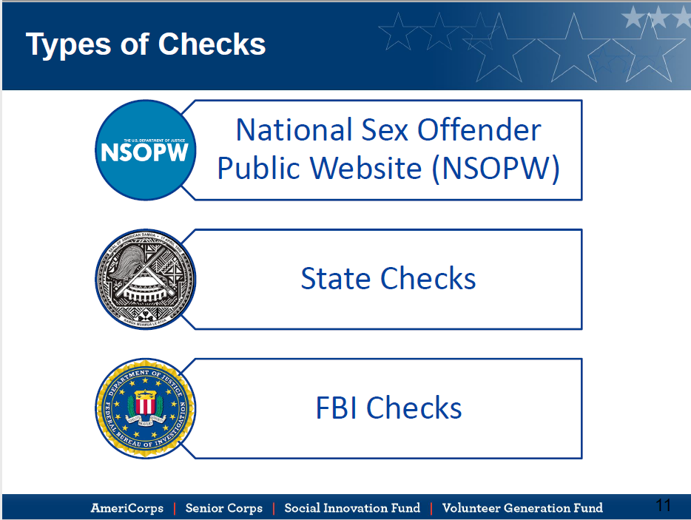
Notes:
The types of checks that are required for every AmeriCorps member and staff person who’s time is being charged to the grant are the NSOPW.gov check, state of service or work (California) and if applicable, the state where the applicant resides at the time they submitted their application (also known as the out of state check), and a fingerprint-based FBI check. This includes partners and site supervisors if their times is being charged to your grant – even if it’s only on the in-kind match side.
For each check you must use a CNCS-approved state repository. For California, the Cal DOJ is the only approved repository of criminal history information. It also happens to give you both the state of California and FBI check if you check both boxes on the LiveScan form – so you can kill two birds with one stone. For other states (if your applicant is applying from another state of residence at the time they apply) you’ll need to check what the approved repository is for that state. The list of each state’s approved repositories of criminal history information can be found on Grantee Central.

Slide 8
California:
CV exceeds CNCS’ minimum requirements:
View all populations as vulnerable – so ALL staff and AmeriCorps members must have all checks
Must be CLEARED prior to start -- No ‘accompaniment’
NSOPW – requirement to repeat annually on AmeriCorps members
Notes:
The key differences between CNCS minimum requirements and what is required by CV, are that from a risk standpoint, we view the members themselves as vulnerable, so ALL AC members and staff must have ALL checks done – state checks, NSOPW and FBI. CV also requires that the checks are completed (not just initiated), results received, and a CLEARANCE decision made and documented, prior to any hours earned on the AmeriCorps grant. Lastly, we require that for returning AC Members you must repeat the NSOPW.gov check each year. If the returning member has more than a 120-day break in service, they will need all 3 checks again. The CNCS website has great resources for training, but you should always keep these differences in mind when using those.

Slide 9
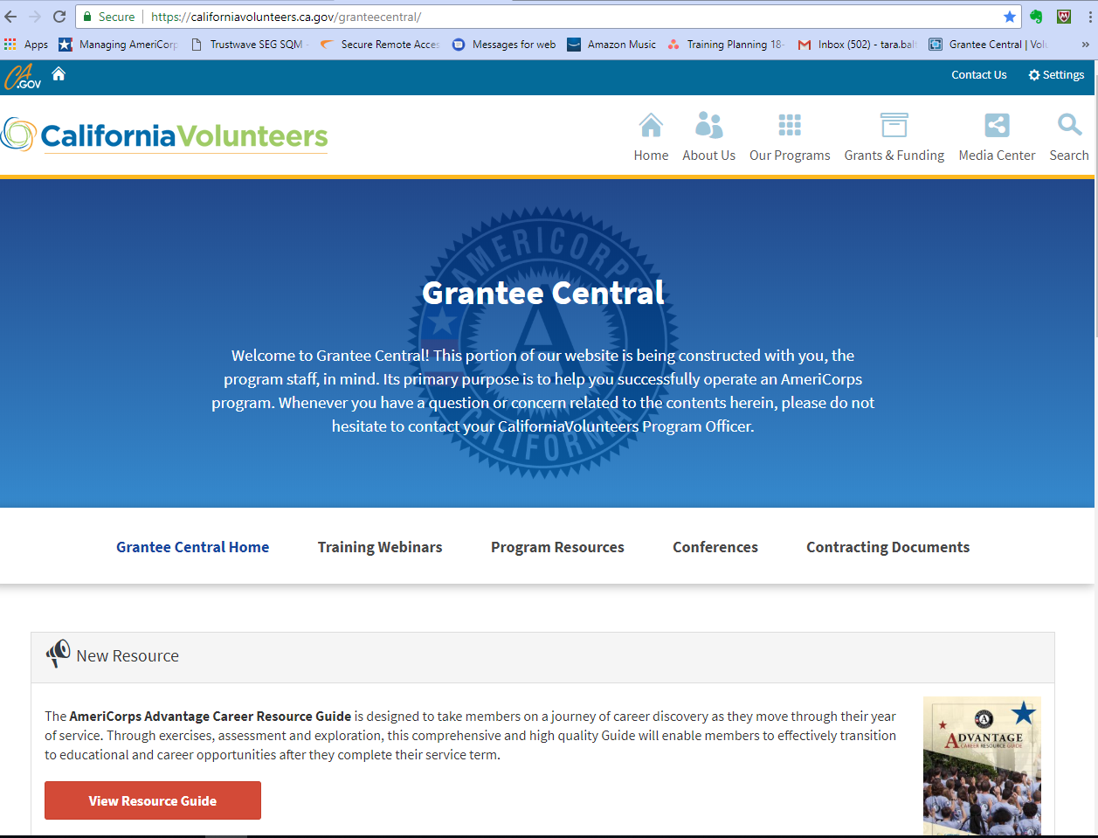


Notes:
https://californiavolunteers.ca.gov/granteecentral
To help avoid confusion, CV’s Grantee Central has a whole section dedicated to CHC Resources [next slide]

Slide 10
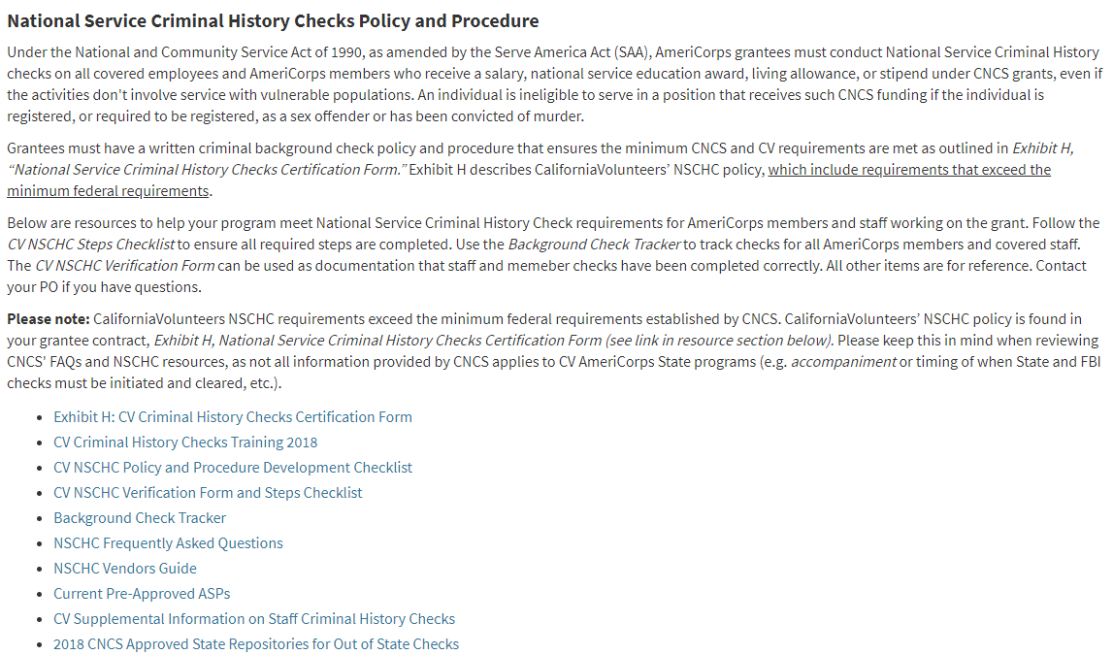
Notes:
https://californiavolunteers.ca.gov/granteecentral/resources/
This section includes CV’s NSCHC Verification Form and Steps Checklist which cover all the steps involved in conducting checks properly and provides the required form to document the checks for each AmeriCorps and staff member on the grant. You’ll also find the updated 2018 version of NSCHC FAQs and a CV Supplemental Information on Staff Criminal History Checks that puts together all the relevant FAQs for running staff checks.
Not on the website, but also available, is a sample HR letter which might be useful to those of you who have schools or partners performing checks for them. The letter makes sure that the school or partner is following all of CV requirements, rather than just their own, such as the approved repository, the fact that results may not be shared, and confirmation that applicants must adhere to the CNCS minimum requirements in order to be considered. Reach out to us if you need that. As a reminder, we always recommend running the NSOPW.gov check yourselves – as it’s not something that HR departments or schools would typically be doing as a matter of course.

Slide 11
NSCHC Reminders & Tips
NSOPWs – must be before start of work or service – accrual of any kind of hours
  Same-day NSOPWs are problematic
  Be sure to note resolving any ‘hits’
  Sign and date the printout
Use CV’s NSCHC Verification Form and Steps Checklist
Be sure to do any new staff listed on the budget (match or CNCS)
Background Check Tracker –
  Due to CV on day 45
  Must self-report any late checks before submitting the tracker
Notes:
[KM] Reminders: CNCS is getting stricter on same-day/morning of NSOPWs. While we understand an NSOPW run the morning of training before members arrive is technically ‘BEFORE’ they start, that’s problematic from a number of angles – what if a registry is down? What if it comes back with hits and you have to resolve them all before starting training? It also requires comparing the printout timestamp with the member’s first timesheet to validate it was run prior – that’s not something you want to have to prove to an auditor. We covered this on the August call so we don’t anticipate seeing any, but wanted to remind folks again.
Please be sure to use CV’s NSCHC Verification Form and Steps Checklist to document the checks – especially since California state law prohibits retaining and sharing the actual results – CV’s form meets the CNCS requirements for documentation. Also be sure to do checks on any new staff listed on the budget whether funded by CNCS or your match.
CV’s Background Check Tracker, which is due to CV 45 days after the start of your members, is a helpful tool to track it all. You must self-report via email any late or missed checks before you submit the tracker to us in order to qualify for the reduced penalty that comes with self-reporting. Reach out to us if you need the Self-Report form, if you discover any noncompliant checks.

Slide 12
Quick re-cap of CNCS’ new eGrants enrollment process
Notes:
Now let’s do a quick re-cap of CNCS’ new eGrants enrollment process, which includes a new section where you certify having completed Criminal History checks. On last month’s call we went through this process very thoroughly – but since many of you are now just starting, and some folks missed that call, we want to highlight it once more.

Slide 13
Multi-step eGrants Member Enrollment
Steps to conduct PRIOR to MemberSTART
Verification of SSN validity and citizenship eligibility automatically (or later manually) in Portal when member accepts invitation
2. Before AmeriCorps member’s first day of service:
  Complete NSOPW.gov
  Initiate State/FBI background checks (California requires all checks are CLEARED prior to member start)
  In portal, verify these steps are completed and hit SAVE!
3. Certify member enrollment (Enroll!) no later than 5th calendar day from member’s start
Final Step: within 5 calendar days of start
Notes:
[Review slide].

Slide 14
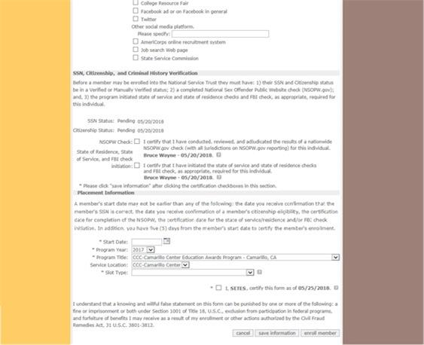
Step 2 -- New Section:
SSN and Citizenship Verification
This is a new section of the enrollment form; programs will see the SSN and citizenship verification status. In this example, both are pending. This means the member’s information is being verified by SSA.
Notes:
Here’s a view of the egrants portal. When you click on a member name in the Pending Enrollments, you’ll see this new section. Again, once the potential member completed their part of enrollment, it immediately sent their info to Social Security Administration for validation. The status of that validation will show up in this section as either ‘pending’ or if it happens quickly, ‘verified’ or possibly, ‘returned’. You will have to continue to check here to see if it’s been verified – unfortunately, you won’t receive any separate notification.
Note there is a field for SSN and a field for Citizenship. Here they show ‘pending’ – still under review. If either or both show ‘returned’ you’ll need to submit those documents to the help desk. If additional documentation is sufficient to verify eligibility, then CNCS staff will manually update the Portal record and the enrollment process will continue. You’ll need to check the portal and look for a status update to ‘manually verified’. Again, you won’t receive other notification. If the additional documentation you submitted is not sufficient to establish eligibility, the program will be notified, and the member cannot be enrolled.

Slide 15
Additional Tips
SSN Documentation Submittal Process:
Help desk via phone or chat is best
Request a Secure File Transfer Link from CNCS (via phone or chat is best)
Request a help desk ticket # at the same time
When submitting the documents, title the file name “Pending Enrollment”
Since there is no NSPID# include: First/Last Name, date of birth, email, and the Grant ID number.
Check member status daily, until you see ‘Manually Verified’
Do not request a new help desk ticket # or resubmit documents, per CNCS instructions.
Notes:
[KM] Based on what we’re hearing from the rest of the country, contacting the help desk via phone or chat is the best method as the webform request has been having trouble. Call and request a Secure File Transfer Link from CNCS. When you request the link, request a help desk ticket # at the same time. This is vital for checking on the status of the member, if there is a delay.
When submitting the documents, title the file name “Pending Enrollment” to expedite processing. This will move the member to the front of the line (rather than with the other eligibility items from this summer). In the past, you have included the member’s NSPID# in the manual verification process. Since the member is not enrolled, they will not have an NSPID#. Instead, document on the form: First/Last Name, date of birth, email, and the Grant ID number.
Check the status of the member daily, until you see that their status has changed to ‘Manually Verified’. Do not request a new help desk ticket # or resubmit documents, per CNCS instructions. Again, email communication seems to have the longest response time; phone or chat function seem to work better, currently.

Slide 16
CHC Verification – MUST be done before the member START date
Programs will verify the NSOPW is complete and that State/FBI checks are initiated, per CNCS requirements. In California, they should have CLEARED for you to check these boxes.
Don’t forget to hit the ‘save information’ button after checking the boxes!
Be sure to select ‘Save Information’ after entering the requested information. This MUST be done before the member’s START date. There is a time stamp that will be generated with this date.
Notes:
Next, let’s look at the CHC Verification section in the egrants portal. At this point, you are not yet ENROLLING the member, you are just certifying having completed Criminal History Checks. After checking each box, when you hit SAVE INFORMATION that day’s date, along with your name, will appear next to each criminal history check. IMPORTANT: You MUST complete this step BEFORE the member’s start date. Later, when you’re ready to the enroll the member, the system will not allow you to enter a START date that occurs before the date you completed this step.
It is also important to note that the dates that will appear next to each Criminal History Check box (which will be the date you do this step) are not the same as the actual CHC Clearance Dates. CV will still refer to the member’s CV NSCHC Verification form to validate the dates each check was cleared in our file reviews.
Some of the problems our programs have encountered: 1) Didn’t do this until 2 days after member orientation – since the system won’t activate the enroll button until this CHC step has been completed and you’ve hit ‘save information’, and it won’t allow a start date to be entered that precedes the date you validate the CHC checks in here, unfortunately members hours for those first two days are in question. We’ve also heard from programs that checked the boxes but forgot to hit the ‘save information’ button. When they returned later to enroll the members, they had to re-do this section. While we’re all hoping for leniency for mistakes like this, and we encourage you to contact the help desk and get a ticket, it doesn’t sound like there is going to be much wiggle room on this new process. So please be sure that everyone on your team who could potentially enroll members is trained on this new system.

Slide 17
Final Step: Enter Placement Information & Enroll member!
The text for this section of the enrollment form is new; programs will enter placement information prior to enrolling the member. California requires ALL CHECKS are CLEARED to do this final step!
This final step of enrollment has to be within 5 calendar days of the member start date.
Notes:
Everything up to this point was really pre-enrollment! Now, once the SSN & Citizenship are showing ‘verified’ or ‘manually verified’ and the CHC are all CLEARED and you’ve certified that in the portal and hit ‘save information’, the ENROLL MEMBER button will finally be ACTIVATED. Then, just like in the past you:
Enter member start date
Enter service location
Enter slot type
Check Certification box
Hit Enroll Member (do not hit this button until all CHC checks are CLEARED) location. The final step has to be done within 5 calendar days of the member starting (with their start date as DAY 1):
Again, in California, the start date you enter CANNOT be before ALL Criminal History Checks have CLEARED. Good practice would be to cross check the member’s NSCHC Verification Form and look at the clearance dates to ensure you are entering a start date that is after CLEARANCE OF ALL CHECKS. CV will cross check the start date against those dates during file reviews. Those are also the dates you’ll note in your CHC Tracker Form for submittal to CV.

Slide 18
How’s the new process been for you?
Let us know in the chat box . . .
Notes:
CV is gathering feedback for CNCS on this process – so please let us know what’s gone well and what’s been challenging. If you have a lengthier answer, you can always email your PO [wait 30 secs for entry]

Slide 19
CV Updates
CNCS Symposium Update
  TrueScreen & Fieldprint – New CHC Vendor option starting in November
  Branding Campaign – new AC PSA
    https://youtu.be/KhCyOtwX7Ws
ASC 2018 Innovation and Leadership Awards
Notes:
Several CV staff braved the pending hurricane and traveled to the CNCS National Symposium last week. One update that is exciting is that the Corporation has completed the long process of vetting and selecting a national vendor to conduct Criminal History checks. Starting in November this vendor will be an option for all grantees to use and their process meets CNCS requirements. They are able to do all checks – state, FBI and NSOPW. We’ll have more information on that in the near future but wanted to share it as potentially an exciting new option for programs. There will be a new marketing campaign by CNCS for AmeriCorps and they released a new AC PSA. You can check it out on their website.
ASC held an event and gave awards for innovation and leadership [next slide]

Slide 20
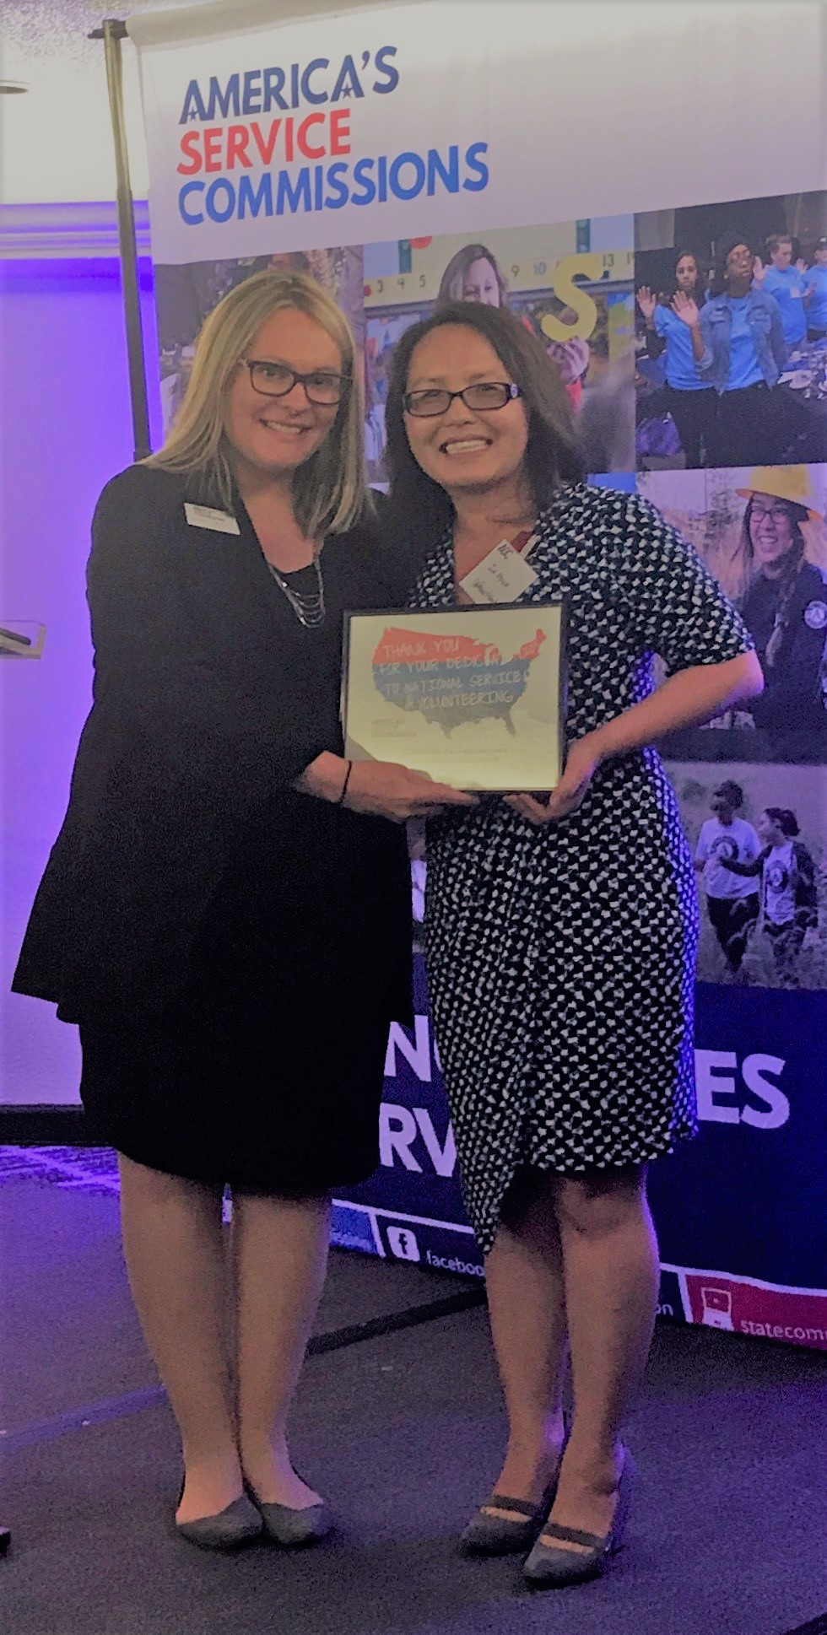
ASC Award: Outstanding Commission Staff:
Ia Moua
Notes:
We’re very proud to share that our amazing Director of AmeriCorps, Ia Moua, received an outstanding commission staff award!

Slide 21
My AmeriCorps Experience
By [Inset Name Here]
Notes:
In addition to the new PSA video, CNCS has created an AmeriCorps Recruitment powerpoint presentation that has high quality photos and places you can embed your own program information, member stories, etc.

Slide 22
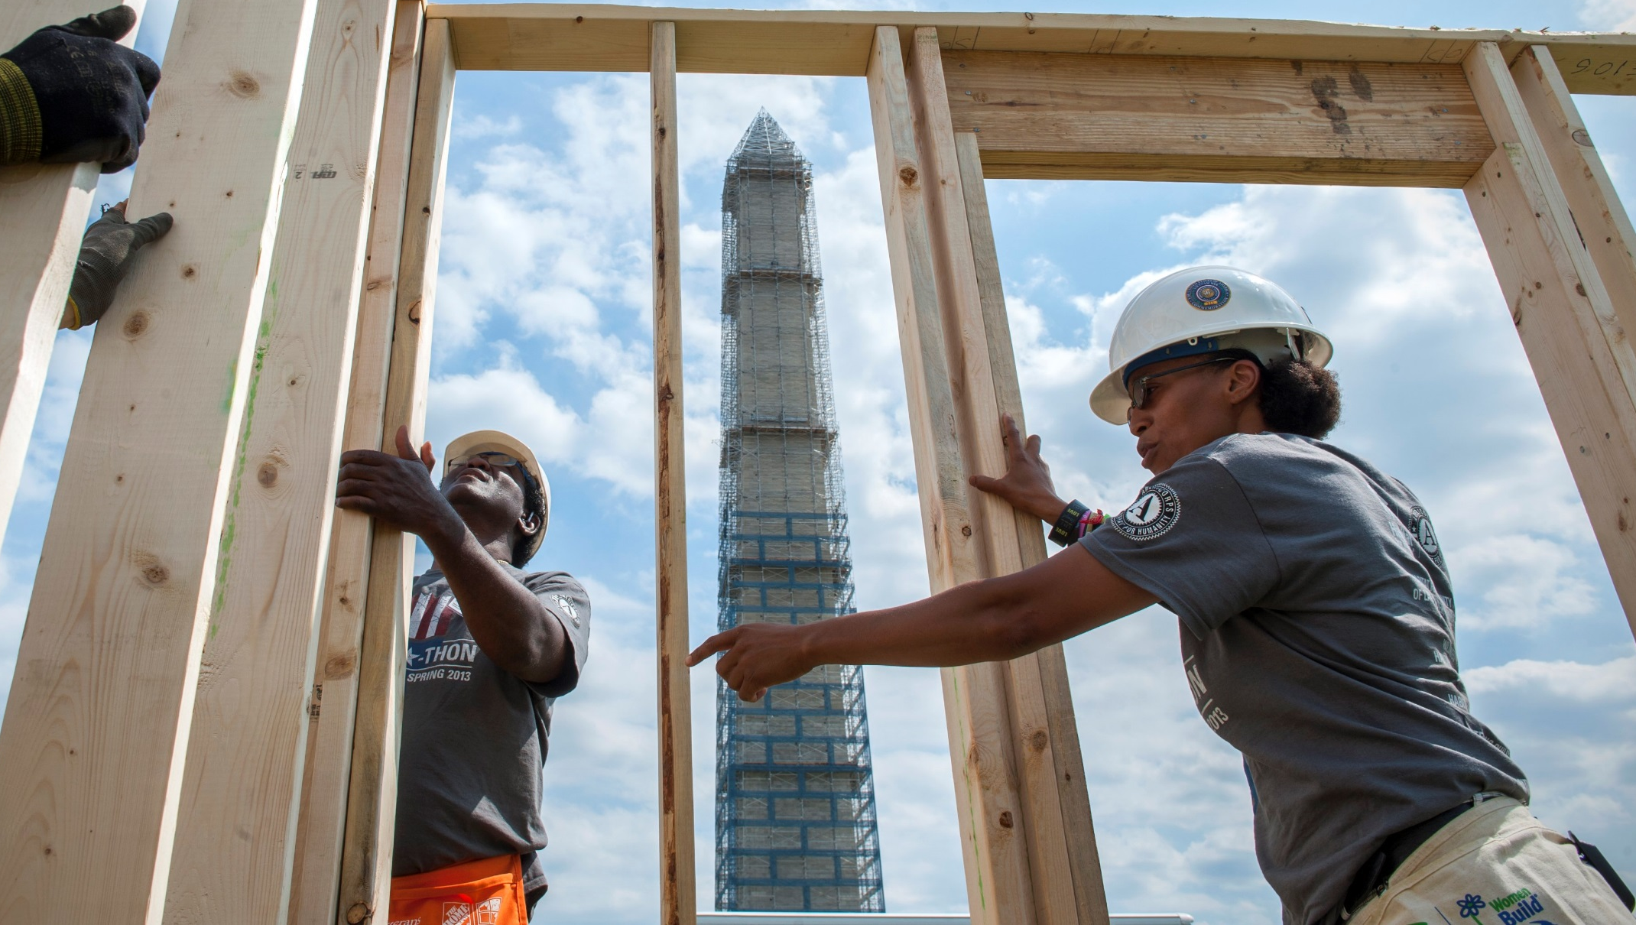
What is AmeriCorps?
Like the Military or Peace Corps, AmeriCorps is a way to serve your country.
AmeriCorps members make Americans safer, stronger, and healthier. They strengthen our communities and above all, get things done.
Notes:
You’ll see you can download it from gotowebinar for use later. Let us know if you find it helpful.

Slide 23
CV Updates
Grantmaking update
  RFA is coming soon watch your emails and the Grants & Funding section of CV’s website
  webinars will take place in October
Training Calendar is coming soon – thanks for your input! – required monthly calls on 3rd Thursday
If you have a topic or presenter to share, let us know!
Tentative Conference Plan: ASC Regional Training in Spring – with a CV pre-day
Boot Camps in Winter & Summer for new programs & staff
Notes:
Now we’ve got a grantmaking update from Patrick.

Slide 24
Questions?
Please mute yourselves until you ask a question
Notes:
We’re going to unmute you all. Please mute yourselves until you ask a question.

Slide 25
Thanks everyone!
Next TTA Call is October 18 @ 10am
Notes:
The next required monthly call is Thursday October 18 – the Full Training schedule will be coming soon so there may be optional webinars before then. There will also be grantmaking webinars coming up and you’ll see those posted on our website in the Grants & Funding section. Those are open to anyone and helpful for all!

