Slide 1
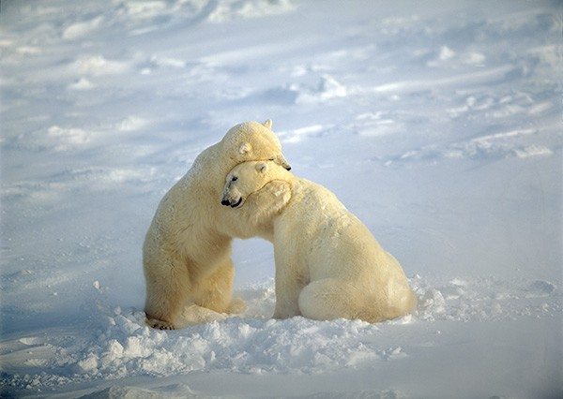
Supporting Members Who Struggle
Notes:
Good morning everybody! We hope you are all doing well. We’re going to mute everyone now and we’ll unmute later for questions & discussion.

Slide 2
What we’ll cover
Supporting Members Who Struggle: Laurie Vargas – Healthy Choices AmeriCorps
Field Perspective: Kathleen Paranthaman – Monterey County United for Literacy
CV Updates
Q & A
Notes:
On today’s call we’re excited to have not one but two of your peers sharing on this important topic. After hearing from both of them, we’ll finish with some important CV Updates and Q&A. I know it’s tempting to multi-task, but I know both speakers have a lot of helpful insights to share and I hope you’ll give them your full attention. If you have questions as we go, enter them in chat and we’ll cover those later, during a short discussion time. This will also be an opportunity for you to share what you do to support members.

Slide 3
Supporting Members Who Struggle
Notes:
We know this time of year can be a particularly challenging time for members, and for program staff as well, as you try to support members. We’re excited to have a fellow program manager, with us this morning, to share on this topic, particularly with a focus on trauma – both previous trauma and vicarious or secondary trauma and its impact on the member service experience. Laurie Vargas, is with SFUSD, and oversees an AmeriCorps program focused on mentoring. She and her team are fortunate to all have mental health backgrounds and bring that expertise to their member support strategies. It’s great to have opportunity to hear from her. Laurie, thanks for being with us, I’ll transfer control over to you now. [Laurie’s presentation was done separately and her slides are separate].

Slide 4
Kathleen Paranthaman
AmeriCorps, Monterey County United for Literacy
Program Coordinator
Notes:
Thanks Laurie, that was very helpful information and we look forward to hearing how folks are able to use it. Now we are going to hear from Kathleen with Monterey County United for Literacy, and AmeriCorps education-based program. Kathleen is going to share some things they’ve done over the past few years that helped them move from some real challenges with member retention and the members’ experience, to now where members are doing better and their retention is well over 90%.

Slide 5
Monterey County United for Literacy – member support strategies
Supporting Members Who Struggle:
-Retention of struggling members was challenging and impacting our program
WHY are members struggling so much and needing to leave?
Top 3 from our team:
1. Financial
2. Health (Mental and general health)
3. Personal life situations

Slide 6
Prevention Strategies
FINANCIAL:
CalFresh
CA Lifeline phones
CA Career Zone budget calculator before accepting program offer
Loan Forbearance or Income Based Repayment
Housing connections/ roommates
MediCal

Slide 7
Prevention Strategies
HEALTH:
AmeriCorps Member Assistance Program (MAP) through America’s Service Commission
Find doctors/ dentists in-network before you are sick
Early Core Training :
Top 7 ways to stay healthy in school environment
Youth Mental Health First Aid
Weekly Team Meetings
Calm & Headspace Apps
Walk & Talk
Self-Care: Yoga, Drum Circle, Zuumba
Members present on physical and mental/emotional health
Presenter: 2nd Hand Trauma and Mindfulness

Slide 8
Prevention Strategies
PERSONAL:
AmeriCorps Member Assistance Program (MAP) through America’s Service Commission
Just knowing its there helps!
Give space/time to use the helpline in our office
Weekly team meetings
Gratitude and appreciation circles
Civic Reflection Series

Slide 9
Monterey County United for Literacy – member support strategies
Things that have worked for our program:
AmeriCorps Member Assistance Program (MAP) through America’s Service Commission
Just knowing it’s there helps!
Give space/time to use the helpline in our office
Calm & Headspace Apps
Weekly team meetings
Gratitude and appreciation circles
Prevention strategies:
Enroll in CalFresh, healthcare, choose doctor/dentist, to be prepared for typical challenges

Slide 10
Supporting Members
What are your thoughts or comments?
Anything you do that seems to work and you can share?

Slide 11
CV Updates
Conference Updates:
AmeriCorps Advantage Program Staff Training part 2:
Sacramento: 2/14: 12-4pm
SF Bay Area: 2/20: 12- 4pm
L.A.: 2/27: 12-4pm or 2/28: 9 – 1pm (pick one)
Member Training (Ch.5) – 3/12: live-streamed
ASC Conference – optional - 3 locations to choose from in May – Idaho has limited space
CV Summer Conference – back by popular demand!
Boot Camp – Summer only / prior to conference
Notes:
B

Slide 12
CV Updates
Criminal History Checks – TrueScreen & Fieldprint
The Exemption Period:
funding is being secured for those who opted in and are re-running some criminal history checks
Special TTA Call for participating programs - date to follow
At this time, grantees are NOT required to use Truescreen, but we anticipate that it will likely be required by CNCS in the future
Future TTA Call for all programs to provide more training and information

Slide 13
CV Updates
Grantmaking: Application package will be submitted to CNCS at end of January
Extended competition for new applications: coming very soon! Applications will due to CV in April.
Formula Continuation: in Spring
Regional Recruitment Update
MLK Day – If you’re participating please register your project at MLKDay.gov – send us photos!

Slide 14
CV Updates
Questions? ? ?

Slide 15
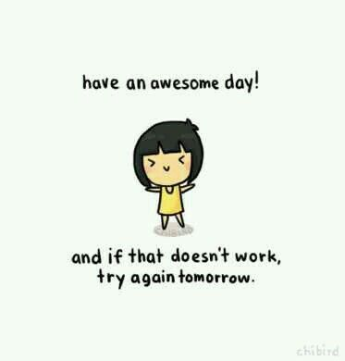
CV Updates

